Slide 1

COVID-19 Live Dashboard
Daksh Trehan 01115602717 (F1)
Priyansh Singhal 03815602717(F1)
Abhishek Jaglan 00215602717(F1)

Slide 2
Project Goal
In the current scenario, there is a widespread of coronavirus in the entire world, but there are limited supplies and services for the patients. There is a fear in the atmosphere regarding mass spread of deadly disease.
To counter the problem, we created a project that aims at demonstrating live stats country-wise as well as city wise in some cases.
To take another step towards challenges, we have also introduced prediction rate, where, one can easily predict recovery rate and prediction rate for any day in future.
Vaccination Analysis is updated to our platform to get better insights for the recovery and measures taken by governments all over the world.

Slide 3
Technological Stack
Python 3
Python libraries: Numpy, Pandas, Matplotlib for Data Analysis
Machine learning for prediction
Django for web deployment
Javascript for dynamic structure

Slide 4
How we sum up as a great team?
Daksh Trehan: Daksh is an analytical guy, with Machine learning oriented career and lateral ability thinking, we can consider him best-in-class AI developer.
Priyansh Singhal: Breathing deep on the mountain, Priyansh is our backend guy, a highly motivating and creative geek who know how to make ML and web together.
Abhishek Jaglan: Designer loves subtle cues, and so does our front-end developer Abhishek, with a great oratory skills and a mind full of creative designs, we just couldn't get enough of him..

Slide 5
COVID-19
“Coronavirus disease 2019 (COVID-19) is a highly infectious disease caused by severe acute respiratory syndrome coronavirus 2".
“The disease first originated in December 2019 from Wuhan, China and since then it has spread globally across the world affecting more than 200 countries. The impact is such that the World Health Organization(WHO) has declared the ongoing pandemic of COVID-19 a Public Health Emergency of International Concern.”

Slide 6
13,61,36,954
5,56,92,113
29,38,200

Slide 7
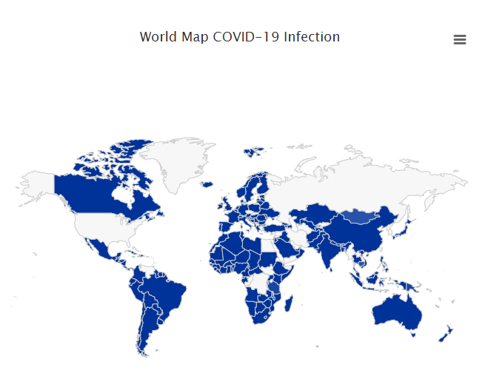
Salient Features
Live interactive COVID-19 stats Country-wise as well as State-wise

Slide 8
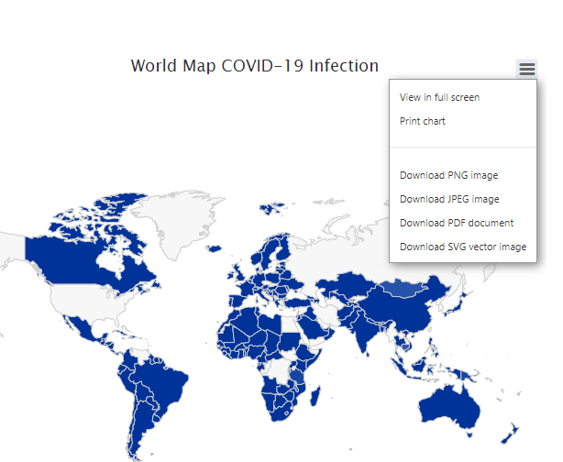
User-friendly and highly feature full.
The dashboard allows users to download live interactive visualized data in different formats.

Slide 9
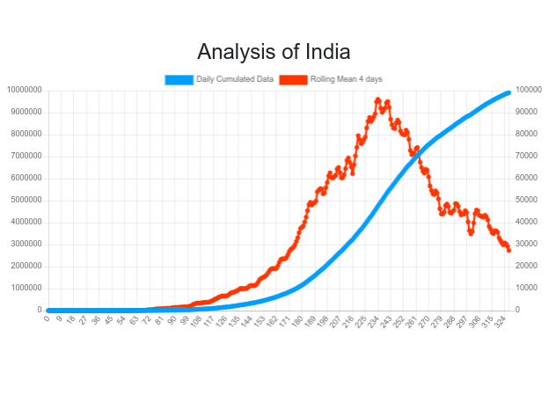
Depicting Rolling mean and Daily Cumulated data for better understanding of Corona wave across the selected region.

Slide 10
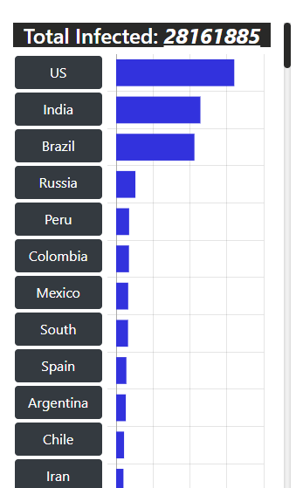
Live Tabular Stats for easy representation and understanding

Slide 11
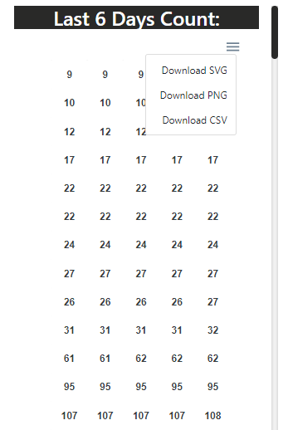
Dynamic 6 days count that allows user to download the count for different regions day wise in various formats.

Slide 12
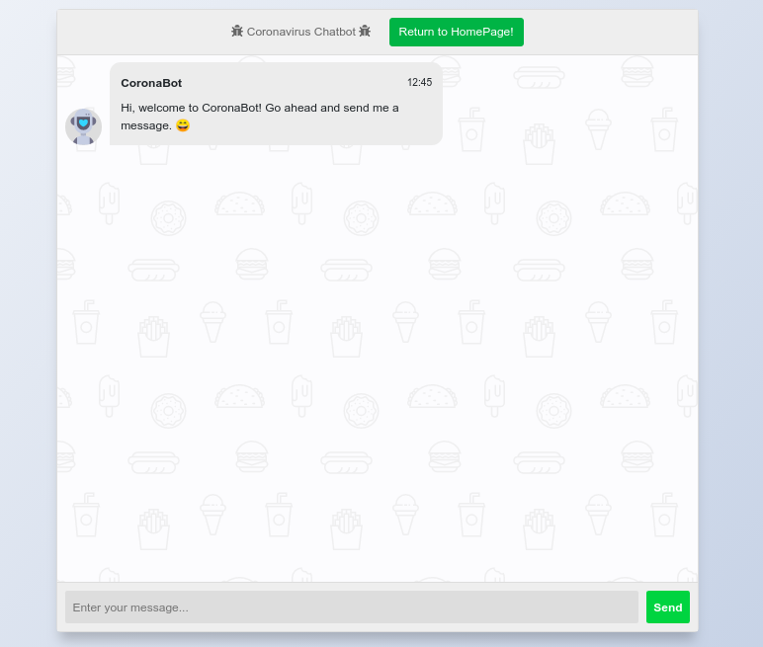
Smart AI powered chatbot offering real-time instant answers to common user queries.

Slide 13
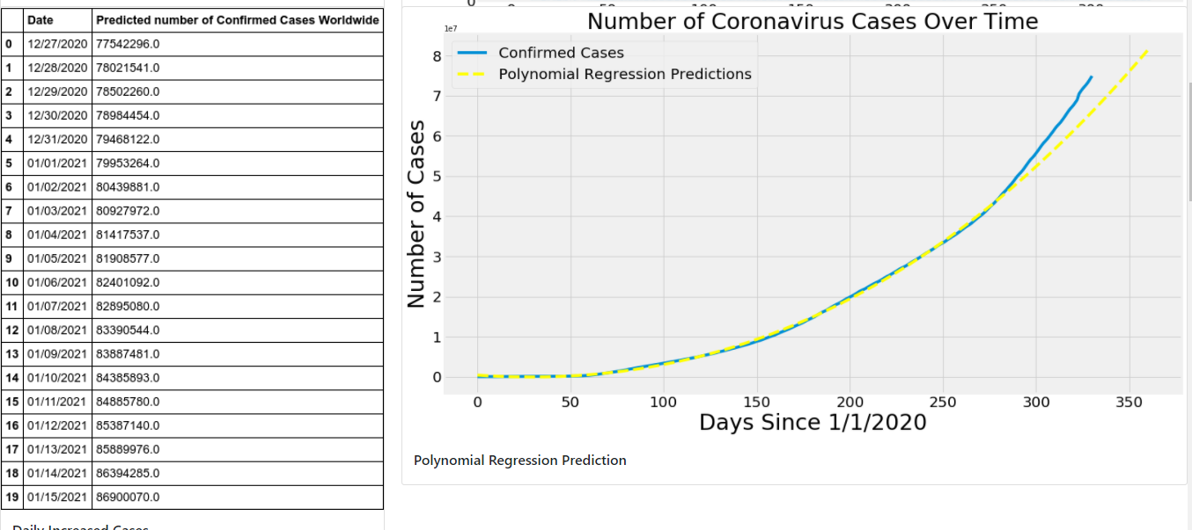
Covid-19 Smart Predictions using Machine Learning techniques

Slide 14
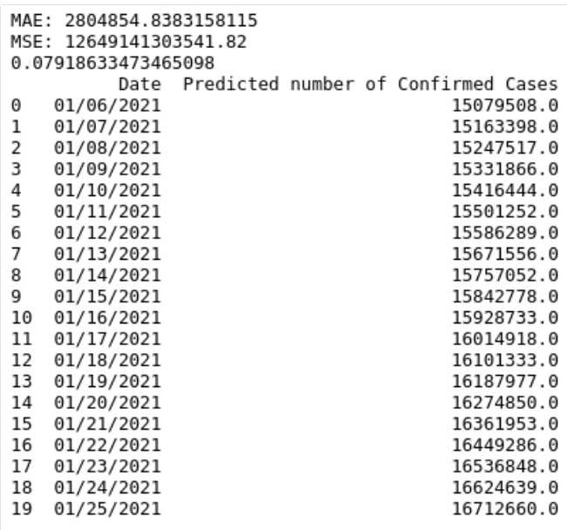
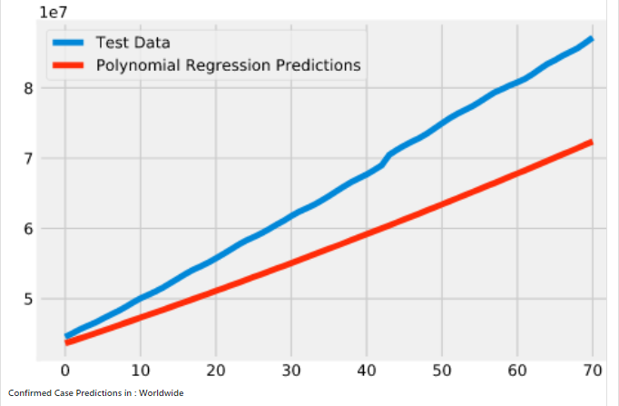
Countrywise prediction

Slide 15
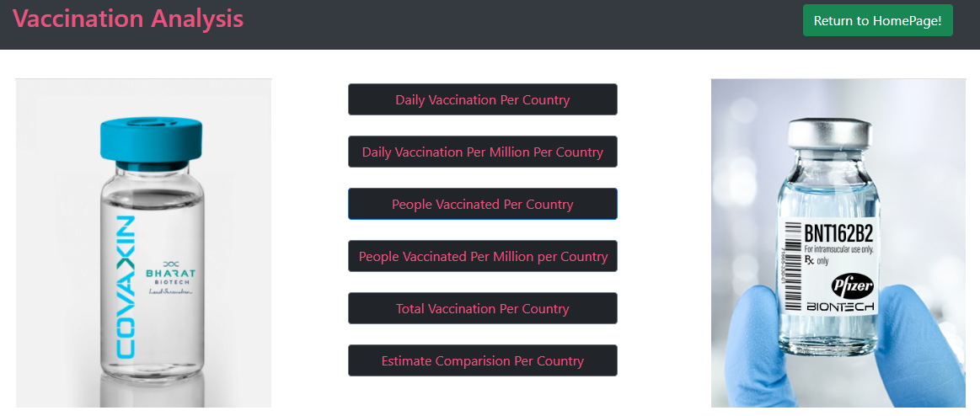
Smart EDA on worldwide vaccination data.

Slide 16
How our project can help audience?
Live Covid 19 Stats - People can monitor the live stats of Coronavirus Confirmed, Active, Recovered cases, etc. in one place.
Prediction rate - To ease the situation, one can easily predict recovery rate as well as infected rate for future course of time.
Real-Time Self-Assessment Chatbot - People can do take their self-assessment checkup by answering the few questions and based on that answers, the user will get the advice by the chatbot such as to quarantine or visit the hospital or precautions if the user is healthy. This will help people in ensuring their safety.

Slide 17
Future Scope
Improvement in chatbot technology to help the users to understand their symptoms and disease in a better way.
Dynamic and Interactive Interface for users.
Live Vaccination Analysis

Slide 18
Thank You

